Slide 1
Arithmetic of random variables: adding constants to random variables, multiplying random variables by constants, and adding two random variables together
AP Statistics B
pp. 373-74

Slide 2
Pp. 373-74 are just plain hard
I don’t like the way they are written
They give you the conclusion, but don’t give you a sense of WHY the rule is what it is
This lecture gives you the derivation of the rules
You do not have to memorize the derivations, but if you understand them, you will understand why the rules are what they are

Slide 3
Outline for lecture
3 basic ideas:
  Adding a constant to a random variable (X+c)
  Multiplying a random variable by a constant (aX)
  Adding two random variables together (X+Y)
Being able to add two random variables is extremely important for the rest of the course, so you need to know the rules
Once you can apply the rules for μ_{X+Y} and σ_{X+Y}, we will reintroduce the normal model and add normal random variables together (go z-tables!)

Slide 4
Remember!
It may be useful to take notes, but this PowerPoint with the narration will be posted on the Garfield web site.
So will a version that does not have narration if you want a smaller file.
Different learning: classes like this that make the lectures available on line require different skills than classes where your notes are all you have.

Slide 5
Beginning concepts
Let’s look at the algebra behind adding, subtracting, and multiplying/dividing random variables.
Here, we will only examine addition and multiplication
  Subtraction is simply adding the negative of the addend
  Division is simply multiplying by the reciprocal of the divisor

Slide 6
Adding a constant to a random variable
The first thing we’ll try is adding a constant c to a random variable.
We will first calculate the mean, and then look at the variance
Remember that given the variance, we can always take its square root and obtain the standard deviation.

Slide 7

E(X+c)=E(X)+c, where c=some real number
For the next slides, we’re going to be expanding the series being summed, and then regrouping the variables and simplifying.

Slide 8
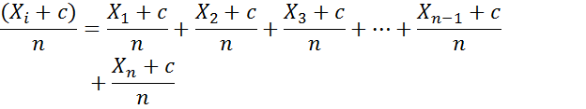
Expanding the series
Let’s expand without the sigma (adding) operator to keep the algebra neater.

Slide 9

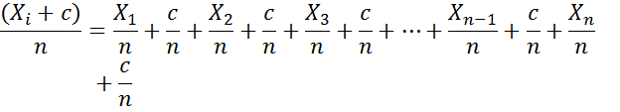
Rewriting the equation
We can rewrite this as a series of individual fractions, since
Thus,

Slide 10

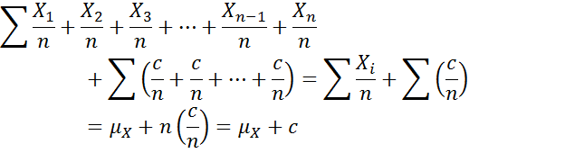
Regrouping the equation
Now, collect like terms:
Note that c/n in parenthesis appears n times
Now, rewrite this as a sum:

Slide 11

Var(X+c)
Var(X+c)=VarX.
We start with the basic definition for variation (VarX):
If we have add a constant c on to random variable X, we have X_{i}+c replacing X_{i}
Remember, the new mean is μ_{X}+c.

Slide 12


Substitute and rewrite the equation
So we substitute X_{i}-c for X_{i}, and μ_{X}+c for μ_{X}, to get:
Let’s again deal only with the numerator and expand the square:

Slide 13
Quite a mess, right?
Look at this:
You wanna simplify THAT?????
So let’s simplify it by NOT expanding the square.
Instead, what is (X_{i}+c)-(μ_{X}+c) equal to BEFORE we square it?

Slide 14

Simple, simple, simple
Distribute the subtraction operator over μ_{X}+c, and we should get:
X_{i}+c-μ_{X}-c=X_{i}-μ_{X}
If we substitute X_{i}-μ_{X} into the numerator, we get our original definition of variation, i.e.,

Slide 15

What about the standard deviation?
The fact that the VARIANCE does not change means the STANDARD DEVIATION does not change, either.
How come? Remember that
Since VAR does not change, the standard deviation also does not change when a constant is added to the random variable

Slide 16
What have we proven so far?
We have looked at the effect of adding a constant to a random variable X, i.e., using X+c
We have 3 conclusions for X+c:
        μ_{X+c}=μ_{X}+c
        σ_{X+c}=σ_{X}
        Var(X+c)=Var(X)

Slide 17

Multiplying a random variable by a constant
Now let’s see what happens when we MULTIPLY the random variable X by some constant a
Let’s look at the mean first: μ_{aX}.
We will substitute aX for X in the definition of the mean:

Slide 18
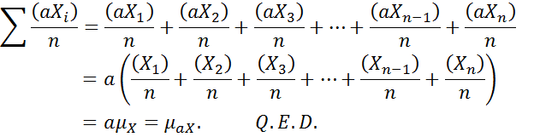
Expand and analyze
Again, let’s expand the X_{i} terms without the sigma:

Slide 19
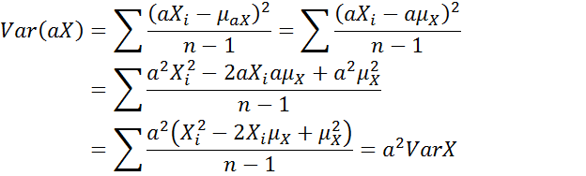
Variance when the random variable is multiplied
Seeing what happens with the variance upon multiplication is similar to adding a constant:

Slide 20

Again, what about the standard deviation?
This derivation also explains why, when we multiply a random variable by a, the standard deviation is a multiple a of the standard deviation of the random variable.
Recall the definition of the standard deviation:

Slide 21
Standard deviation: substitute and solve
Substitute “aX” for X, and we get

Slide 22



Recap of conclusion for aX (multiplying the random variable by a constant
Once again, three conclusions:

Slide 23
Final approach: adding two random variables together
Let’s substitute in X+Y into our formulae to find out how they change
  (Remember that X-Y can be recast as an addition problem X+(-Y), so we do not need a separate derivation for X-Y)

Slide 24
Calculating the mean when adding two random variables
We again start with the standard definition of the mean, except that we substitute “X+Y” for X:
Once again, calculating the mean is easy peasy.

Slide 25
Calculating the variance
The variance, of course, will be harder and messier. In fact, the derivation is so bad that you’ll have to accept this one on faith:
Var(X±Y)=Var(X)+Var(Y)

Slide 26



What about standard deviations?
First, let’s derive them from the Var formula
Since ,
Therefore:

Slide 27


Recap of adding two random variables together

Slide 28

Here endeth the lesson.
You are not responsible for these derivations, but I hope it helps to explain why the forms on pp.373-74 are what they are.

